Slide 1
CS 744 Postscript

Slide 2
ML Review
Data parallelism
Parameter server
Model parallelism
Consistency
Programming model
Inference

Slide 3
Main challenges, ideas
How to scale training to large data sets (n) and large models (w)? Fast training?
Ideas:
Data parallelism
Model parallelism
Consistency models
Systems tricks to speed things up

Slide 4
Data parallelism
Distributes mini-batch gradient computation across workers → data parallelism helps speed up stochastic gradient descent based training
Updates to the model can happen in one of two different ways → structuring the system appropriately can help make this efficient
Peer-to-peer, or some aggregation topology
Each worker stores model; receives gradient updates from everyone else;
When gradient updates are synchronized (received from everyone), model is updated
Coordination is hard -- complex local worker logic
Somewhat difficult to control communication overhead
Parameter server
Separates out aggregating and synchronizing model params and updates

Slide 5
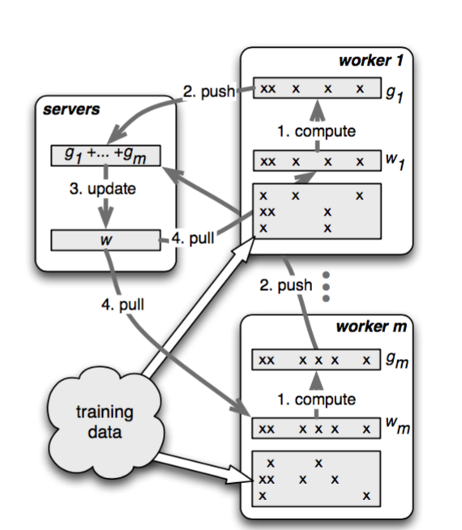
Parameter server
Positive side-effects:
Fault tolerance -- nothing ML-specific; just becomes easier
Can implement different consistency models → better compute/comm overlapping
Elasticity and fault tolerance semantics are simpler

Slide 6
Consistency
Synchronous -- wait for all workers updates. Update at server. Then workers pull update and move to next iteration.
Converges, but wastes resources and stragglers can hurt → how to avoid/overcome stragglers
workers idle in between iterations
Asynchronous -- updates from a worker applied immediately. Workers can pull right after
Makes more efficient use of resources
But, workers can operate on models of unbounded staleness
May not converge
Stale synchronous -- in between the two extremes

Slide 7
Asynchronous vs synchronous
… Is not a systems problem! Asynch and synch are different algorithms.
Synchronous execution is clear → updates from all workers are gathered before applying to the model. Convergence is known.
Asynchronous execution → making updates and using updates are decoupled. Worker makes update → guaranteed to see its updates; some recent updates of other workers updates may be seen. Known to diverge.

Slide 8
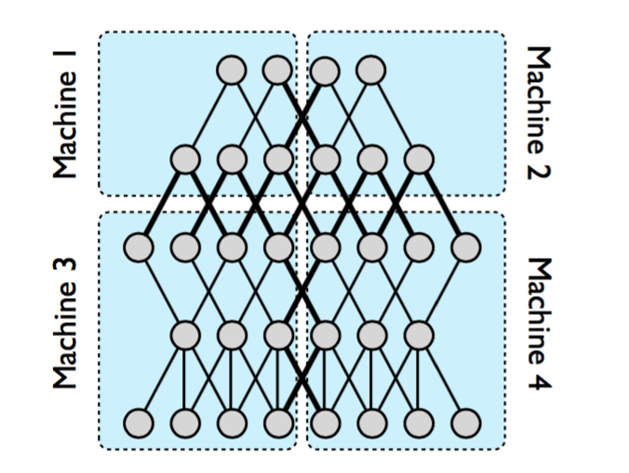

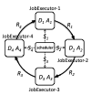
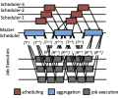
Model Parallelism (DistBelief, STRADS)
Two main observations: parameters may be dependent, thus naive concurrent updates can introduce errors that slow convergence; (2) model parameters converge at different rates, thus a small subset of parameters can bottleneck ML algorithm completion.

Slide 9
Programming model (TensorFlow)
Tensorflow, e.g. → largely tied to algorithm specifics, as opposed to system-level requirements.
Contrast with Spark’s use of RDDs.
RDDs were about efficient fault tolerance and in-memory computation.
It is application agnostic.
Allows multiple different applications to be written atop and benefit from RDDs
ML programming models push the level of abstraction closer to apps. Lose generality but better meet application-level programmer goals.

Slide 10
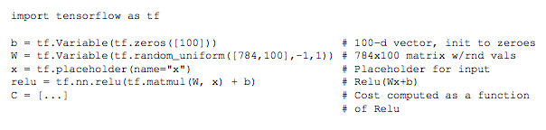
Programming Model
Directed Dataflow Graph to express computation

Slide 11
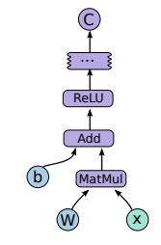
Programming Model
Directed Computation Graph - Symbolic
Variables - Nodes can be stateful
Each node is an operation
Tensors flow along edges

Slide 12
Programming Model
Sessions to interact with the Tensorflow System
s = tf.Session() s.run(C, feed_dict={x: input})
Tensorflow takes care of executing the graph on the underlying machines
Operators - Kernels

Slide 13
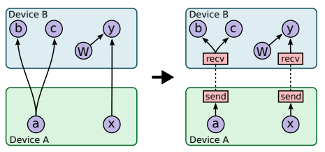
Execution Model
Placement of different modes on to underlying devices / machines: Greedy
Example

Slide 14
Extensions
Gradient Computation
Partial Execution
Device Constraints
Control Flow
Input Operations
Queues
Containers

Slide 15
Scheduling (Gandiva)
Leverages predictable iterative nature of ML. Ensures affinity as much as possible.
Mechanisms:
Migration, suspend-resume, elasticity, profiling (used to trigger different mechanisms)
Introspection:
Migration, time slicing and elasticity triggered in the background based on constant profiling.

Slide 16
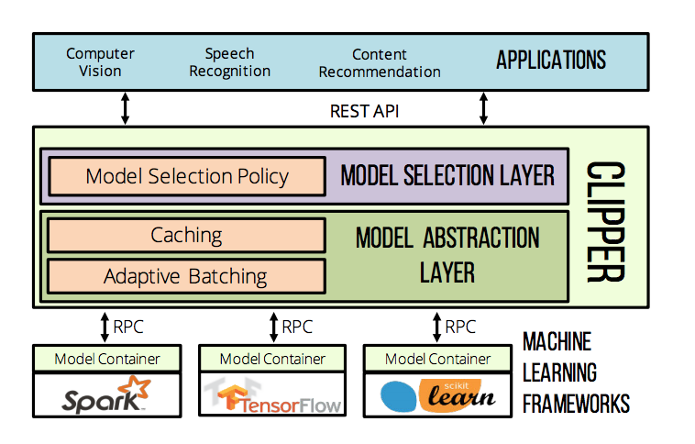
Training vs Inference
Scalable inference is largely open. E.g., how to use feedback to improve models? Approximating inference? Note: inference is not really a “big data” problem. :)

Slide 17
Graph Analytics Review
High level definitions
Pregel
GraphLab
GraphX

Slide 18
Graph Processing
How to compute: iterative, vertex-centric processing. “Think like a vertex”
Vertex runs a program, with local state, or “value”
Each iteration, vertex gets input from other vertices about some function of their state. It accumulates this (“gather”), modifies its state (“apply”), and prepares sending this to other vertices (“scatter”)
Two sets of ways of doing this:
message passing, distributed shared memory;
synchronous (all iterations proceed in lock step); asynchronous (each vertex can process whatever partial messages it receives or data it reads)

Slide 19
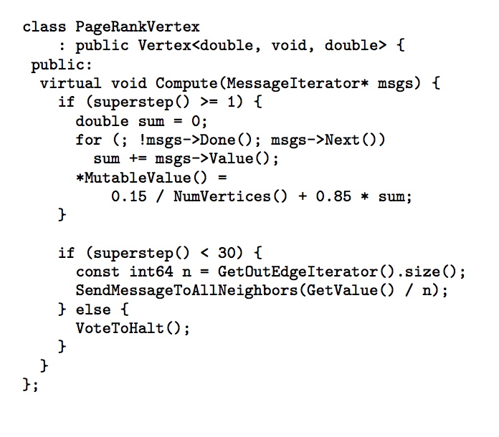
Pregel
Synchronous message passing
Vertexes start iteration by gathering; then they apply, and then they scatter.
Messages carry values along edge (E.g., page rank/degree)
Scattered messages are buffered at recipient vertices.
Iterations coordinated by a Master.

Slide 20
GraphLab
Uses distributed distributed shared memory
In gather phase, a vertex reads values from neighboring vertices
Systems ideas for performance: delta caching, conflict free vertex activations
Vertex has access to neighbor data any time; in Pregel need messages explicitly
Good for dynamic algorithms (page rank, where converged nodes can “stop executing”)
Also easily supports parallelism

Slide 21
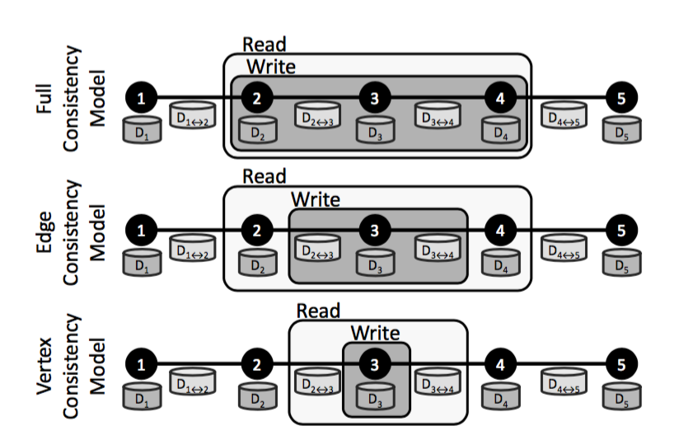
GraphLab consistency models
Full consistency: “scopes” of concurrently executing updates don’t overlap
“Scope” → neighborhood of a vertex
Full → full read/write access to all data within a scope
Edge consistency: a vertex has read/write access to itselfs and edges incident and read-only to adjacent vertices
Vertex consistency: all vertexes can run in parallel, enabling full parallelism
Updates to shared state needs locking. GraphLab has a graph-centric locking approach where vertexes take turns

Slide 22
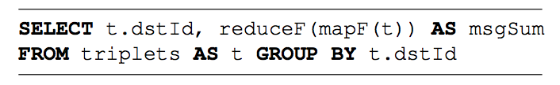
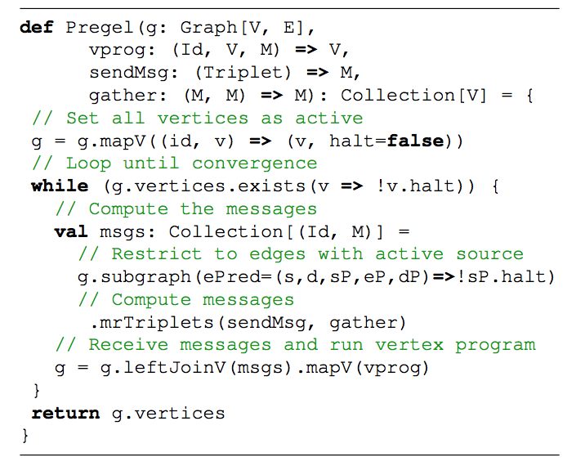
GraphX
Data organization -- vertex and edge collections (tables)
Vertex cut partitioning for the edge collection -- introduced first by GraphLab
Graph processing realized using relational operators
Create a triplets view
Run triplet.mrtriplets(map, reduce); For example, t.mrtriplets(sendmsg,gather)
Thinking of data as collections allows use of relational operators, e.g., use of indexes

Slide 23
Execution
Similar to programming model, execution advancements are also tied to application specifics. E.g., leveraging special hardware to efficiently run ML kernels, optimize communication, etc.

Slide 24
Other Topics’ Review
StreamScope
Serverless Computing
Approximation

Slide 25
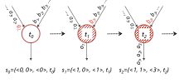
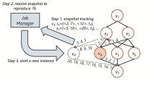
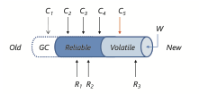
StreamScope
Clean semantics for fault tolerance
Record by record processing
Event time ordering
Exactly once processing
Numbered event streams
Snapshots, recovery
Asynchronous checkpointing

Slide 26
Serverless Computing
New model of cloud computing
Programmers write functions. Infrastructure takes care of launching, and rapidly scaling up/down.
Billing per event. When an event arrives, routed to an existing lambda (if queue is small) or a new lambda is launched.
Cold start latency can be large, but rapid scale out possible.
Stateless, all I/O happens via an external store. Data is always persisted
Interesting programming model, but poor fit for “stateful” apps, e.g., batch analytics, ML, ..?

Slide 27
Serverless Computing Issues
Interesting programming model, poor fit for “stateful” apps, e.g., analytics, ML, graph. Storage is a bottleneck. Need ephemeral state stores
Performance sensitive stateful apps also suffer, eg. streaming
What is it a good fit for??
Efficiency and speed matter, otherwise it is a losing proposition for tenants
How to enable hardware accelerators to become accessible in a serverless fashion?

Slide 28
Approximation, an area of growing interest
A = Q(I)
Multiple approaches: approximate input, by sampling (blinkdb), or approximation computation (quickr, sketches, freeze inference)
BlinkDB key ideas:
Stratified sampling. Over-sample rows from rare QCSs.
Maintain samples for multiple QCSs that have good QCS coverage, occur often, good storage cost, good coverage of sparse QCSs
Build ELPs for a query, and pick a point on the ELP curve that is optimal w.r.t time or accuracy
Many issues: QCS overlap may be small; sample creation is expensive; sample may be as large as original table

Slide 29
Stepping Back

Slide 30
On the very first day: What this class is about...
We will cover:
Cluster architecture
Big Data stacks: Hadoop, Spark, Tez
Scheduling and Resource Management
Batch and stream analytics
Graph processing
Machine learning
Role of serverless platforms
Approximation
Theory, practice and research

Slide 31
10000ft view
Large cluster || Lots of data || Analyze data || Multiple analyses in parallel
How to express computation? Programming model
How to represent data?
How to run computation at scale? Data parallelism, Execution framework
How to deal with run time issues, e.g., slowdowns, failures?
Key properties: Correctness? Consistency?
Questions are common, but diff. types of data may benefit from custom answers.
When are custom approaches needed? Why?
Can a generic system provide the basis to answer above questions for all applications/types of data? At what trade-off?

Slide 32
10000ft view
Issues are not cleanly separable. In many cases, e.g., stream processing, they are intertwined.
We covered these topics for applications where relevant papers exist

Slide 33
Tools and Their Use
Hadoop and Spark ecosystems continue to thrive -- more robust, scalable, efficient
Systems that are widely used: YARN, Tez, Tetris, DRF, Hive, SparkSQL, StreamScope, Structured Streams, Pregel, GraphX (?), ParameterServer, TensorFlow, GraphLab, BlinkDB, Gandiva

Slide 34
What’s next, what’s hot, what’s not (*gulp*)
Cluster scheduling well-mined (you can thank me for that!)
Batch analytics, stream processing, too
In ML, asynch/synch and typical systems issues (replication, FT) well explored, but approximation/quantization is alive
Graph analytics ill-explored
Approximate analytics has limited support (QuickR: sigmod 2016)
Leveraging hardware advances to accelerate big data -- RDMA, programmable NICs, FPGAs, TPUs, GPU → programming model, but also more ground up changes?
OS inefficiencies in big data processing

Slide 35
What’s next, what’s hot, what’s not
Systems advances continue to push ML and Deep Learning
SysML is now a conference! But not sure what fundamentals drive it
A lot of current focus is on RL and NLP
Model serving/inference is unexplored
Verification and testing in the big data context -- how to frame the problem?

Slide 36
What’s next, what’s hot, what’s not
Security, privacy -- e.g., computation on encrypted data; secure MPC? Model inversion attacks and defenses against them
IoT time-series analysis over many data streams)
ML for Sys: Self-driving X (e.g., X = “networks”, “data center”, “routing”, “load balancing”)
Serverless platforms for big data (PyWren, NumPyWren, LambdAPACK,...)
Experimental infrastructure to support this research; datasets

Slide 37
Industry
You now know: Hadoop, MR, Spark, Tez, batch processing, Streaming, Graph analytics, ML, tensorflow, serverless, …
You are unique -- few people have this breadth of knowledge!
Put it on your resume!
Many companies WANT YOU: Databricks, Mesosphere, Snappydata, Hortonworks, Cloudera, Google, Azure, Microsoft, Facebook, AWS, IBM, AMFAM, Uber, ATT, Comcast, … Sell yourself well!

Slide 38
Some general overview and background follows

Slide 39
Generic Systems (“Big Data Stacks”)
Basics:
Cluster architecture, assumptions, constraints,
Distributed storage system design, control plane, data lay out, fault tolerance, semantics

Slide 40
Generic Systems -- Programming Model
MapReduce
Computation expressed as “maps”, “reduces”
Spark
RDDs: immutable partitioned collection of records
Computations expressed as transformations or actions on RDDs
Tez
Computations expressed as a DAG. Each vertex takes generic compute logic.

Slide 41
Generic Systems -- Execution Framework
MapReduce
Data locality for maps; threshold #map completion for reduce; greedy/breadth first vs. critical path scheduling
Speculative execution; cause driven straggler remedy
Spark
Lazy evaluation of RDDs. Wide dependencies and materialization determine how compute is partitioned into tasks. Record streaming vs. persisting RDDs
Speculate or kill/restart
Tez
Similar to MR.

Slide 42
Multi-tenancy
Abstractions -- Mesos (resource offers) vs YARN (asks and grants) vs Omega (optimistic concurrency control)
Fairness (multi-dimensional max-min fair allocation -- DRF)
Packing (multi-dimensional bin packing -- Tetris)
Fairness and packing! (fairness knob -- Tetris; or altruism -- Carbyne)

Slide 43
Batch Analytics -- Representing Data
Support SQL-like processing. Representing compute aligns well with map, reduce, etc.
How to represent data? Improve analysis flexibility (SparkSQL) or analysis efficiency (Hive etc.’s data format)
SparkSQL’s dataframe API -- DFs are RDDs that keep track of scheme
Leverage relational optimizations. Optimize across different stages of a pipeline (Catalyst).
Leverage external datasets

Slide 44
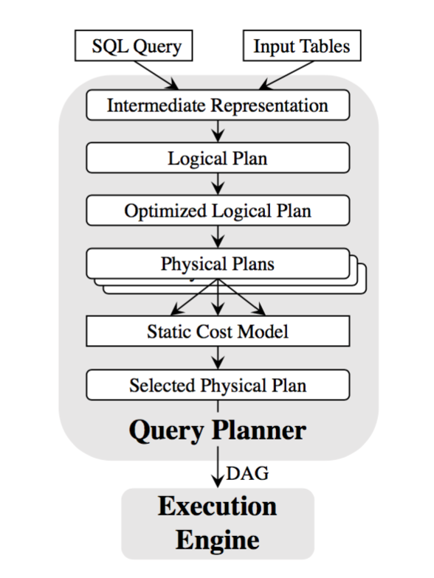
Batch analytics -- query planning
How to support query planning:
Store statistics with files and file portions (Hive)
Logical plan -- optimize using statistics
Multiple physical plans -- use specific data parallel operators, or do other optimizations
Pick physical plan with low cost
Hive’s Calcite SparkSQL’s Catalyst
Clarinet

Slide 45
10000ft view, again
Large cluster || Lots of data || Analyze data || Multiple analyses in parallel
How to express computation? Programming model
How to represent data?
How to run computation at scale? Data parallelism, Execution framework
How to deal with run time issues, e.g., slowdowns, failures?
Key properties: Correctness? Consistency?
Questions are common, but diff. types of data may benefit from custom answers.
When are custom approaches needed? Why?
Can a generic system provide the basis to answer above questions for all applications/types of data? At what trade-off?

Slide 46
Stream processing
Expressing computation: logical DAG of operators; operators are stateful (accumulate information during the course of a stream getting processed)
How to think of the data being processed?
Record at a time (Storm, StreamScope, Flink)
Time slices of input data -- mini-batches (Spark Streaming)
Coupled with logical DAG, has the effect of rolling the DAG out in time
Mini-batches with schema (Structured Streaming)
Trade-off between latency (record at a time is better) and consistency semantics, especially prefix output consistency

Slide 47
Consistency properties
Does the streaming framework support certain properties? Streaming introduces the notion of correctness
Prefix output consistency
Correct event-time or out-of-order processing
Under failures or stragglers:
Exactly once processing

Slide 48
Execution
Typically, focus on single job. DAG deployed at T=0. Tasks stay alive forever.
Goal → good performance, while also supporting consistency requirements
Execution differs depending on data organization approach used:
Mini-batching → similar to batching systems (note: can support multi-tenancy)
Batching trivially gives prefix-output
With schema → trivially get event-time
Record at a time → good systems use metadata to track progress :)
Vector clocks and logical separation of edges, vertexes: StreamScope -- better local recovery recovery, cleaner straggler mitigation
Barriers: useful for DAG-wide asynchronous barrier snapshotting in Flink
Water marks: Flink and StreamScope to do even-time processing

Slide 49
Machine Learning
General issues to consider for any big data system:
Representing data → not much here in the ML systems space, perhaps “tensors”; Data Frames?
Programming model, based on structure of computation → Tensorflow; parameter server; KeystoneML (pipelines vs. single model in other cases)
Performance → data and model parallelism
“Correctness” or “Consistency” → asynchronous vs synchronous;
We did not cover these:
Can training go wrong? (a systems problem)
Can trained models go wrong? (a theory problem)

Slide 50
Breezy Overview -- I
Infrastructure
Networking, storage, compute; their common attributes, implications for design
Cluster management: scheduling, multi-tenancy, placement
Frameworks for big data processing
General frameworks: programming model
MR, Tez, Spark
Execution
Intra-job scheduling, stragglers, fault tolerance

Slide 51
Breezy Overview -- II
Applications -- how they are designed
Built atop general frameworks
Hive, SparkSQL, Clarinet, Spark Streaming, GraphX,
Custom applications with custom programming model
Storm, StreamScope, Pregel, TensorFlow, GraphLab
Applications -- what problem they solve
Batch analytics -- SQL-like queries atop on-disk data; query completion time, makespan
Stream analytics -- queries on continuously arriving data; per-record latency, consistency
Graph processing -- processing graph data; iterative; vertex centric; how to partition, combine with other data; expressiveness
Machine learning -- building large models on large data sets; iterative; approximate; data and/or model parallelism; asynchronous/synchronous; programming model

